Slide 1
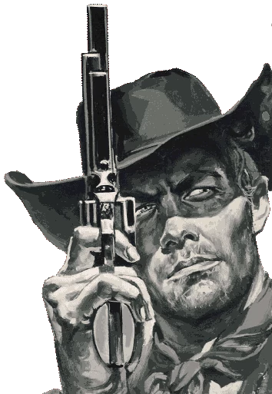
Operation Sharpshooter
Quick-reaction game to crown the Fastest Hands in the West!!!
Coders: Brianna Barnes & Drew Smith
Original Coder: https://github.com/raspberrypilearning/python-quick-reaction-game

